Slide 1
Decision Trees
Lecture notes for Principles of Artificial Intelligence (COMS 4720/5720) Yan-Bin Jia, Iowa State University
Outline
I. Decision trees
II. Learning decision trees from examples
III. Entropy and attribute choice
** Figures are from the textbook site (or by the instructor).

Slide 2
Restaurant Waiting
Problem Decide whether to wait for a table at a restaurant.

Slide 3
Restaurant Waiting
Problem Decide whether to wait for a table at a restaurant.
Output: a Boolean variable WillWait (true where we do wait for a table).

Slide 4
Restaurant Waiting
Problem Decide whether to wait for a table at a restaurant.
Output: a Boolean variable WillWait (true where we do wait for a table).
Input: a vector of ten attributes, each with discrete values:

Slide 5
Restaurant Waiting
Problem Decide whether to wait for a table at a restaurant.
Output: a Boolean variable WillWait (true where we do wait for a table).
Input: a vector of ten attributes, each with discrete values:
Alternate: whether there is a suitable alternative restaurant nearby.
Bar: whether the restaurant has a comfortable bar area to wait in.
Fri/Sat: true on Fridays and Saturdays.
Hungry: whether we are hungry right now.
Patrons: how many people are in the restaurant (values: None, Some, and Full).
Price: the restaurant’s price range ($, $$, $$$).
Raining: whether it is raining outside.
Reservation: whether we made a reservation.
Type: the kind of restaurant (French, Italian, Thai, or burger).
WaitEstimate: host’s wait estimate: 0-10, 10-30, 30-60, or >60 minutes.

Slide 6
Restaurant Waiting
Problem Decide whether to wait for a table at a restaurant.
Output: a Boolean variable WillWait (true where we do wait for a table).
Input: a vector of ten attributes, each with discrete values:
Alternate: whether there is a suitable alternative restaurant nearby.
Bar: whether the restaurant has a comfortable bar area to wait in.
Fri/Sat: true on Fridays and Saturdays.
Hungry: whether we are hungry right now.
Patrons: how many people are in the restaurant (values: None, Some, and Full).
Price: the restaurant’s price range ($, $$, $$$).
Raining: whether it is raining outside.
Reservation: whether we made a reservation.
Type: the kind of restaurant (French, Italian, Thai, or burger).
WaitEstimate: host’s wait estimate: 0-10, 10-30, 30-60, or >60 minutes.
2⁶ × 3² × 4² = 9,216 possible combinations of attribute values.

Slide 7
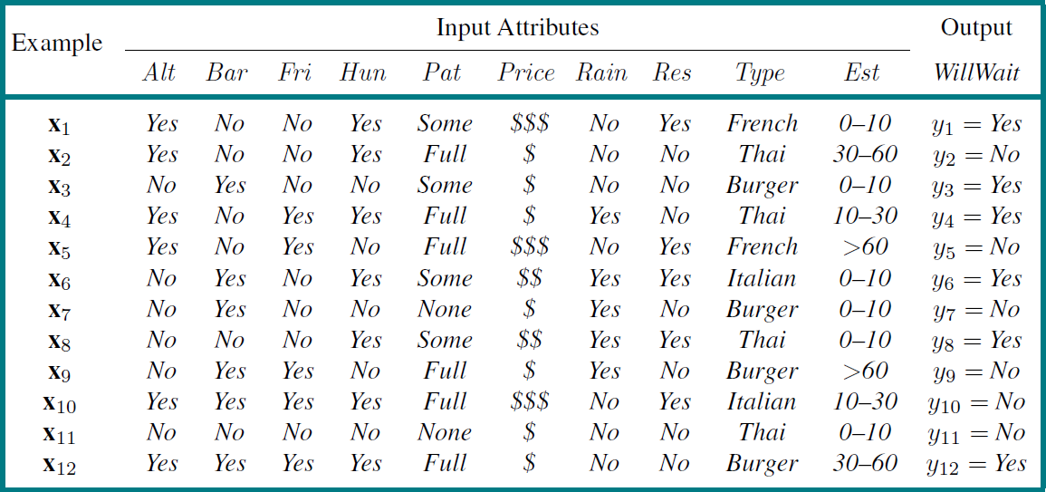
Training Examples
The correct output is given for only 12 out of 9,216 examples.

Slide 8
Training Examples
The correct output is given for only 12 out of 9,216 examples.
We need to make our best guess at the missing 9,204 output values.

Slide 9
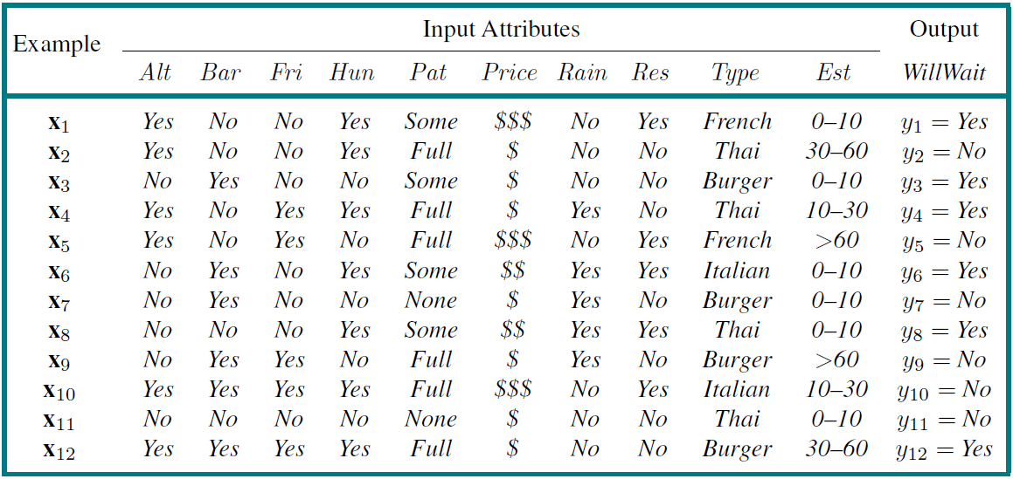
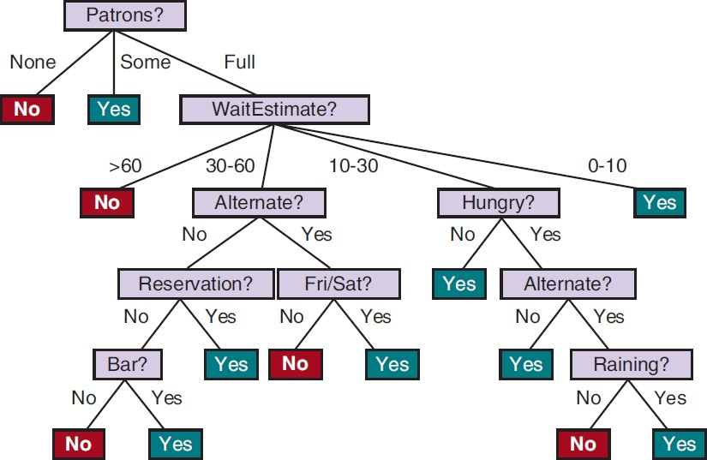
I. What is a Decision Tree?
A decision tree maps a set of attribute values to a “decision”.
It performs a sequence of tests, starting at the root and descending down to a leaf (which specifies the output value).
Each internal node corresponds to a test of the value of an attribute.
𝑇1 : a decision tree for the restaurant waiting problem

Slide 10
Boolean Classification
Inputs are discrete values.
Outputs are either true (a positive example) or false (a negative one).

Slide 11
Boolean Classification
Inputs are discrete values.
Outputs are either true (a positive example) or false (a negative one).
Positive examples:
  Patrons = Some
  Patrons = Full ∧ WaitEstimate = 0−10
  Patrons = Full
∧ WaitEstimate = 10−30
∧ Hungry = Yes
∧ Alternate = No

Slide 12
Boolean Classification
Inputs are discrete values.
Outputs are either true (a positive example) or false (a negative one).
Positive examples:
  Patrons = Some
  Patrons = Full ∧ WaitEstimate = 0−10
  Patrons = Full
∧ WaitEstimate = 10−30
∧ Hungry = Yes
∧ Alternate = No
Negative examples:
    Patrons = No
    Patrons = Full
∧ WaitEstimate > 60

Slide 13
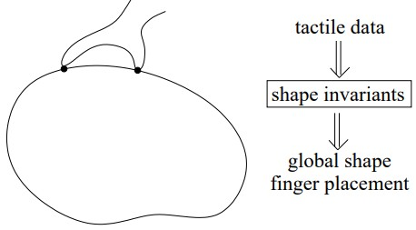
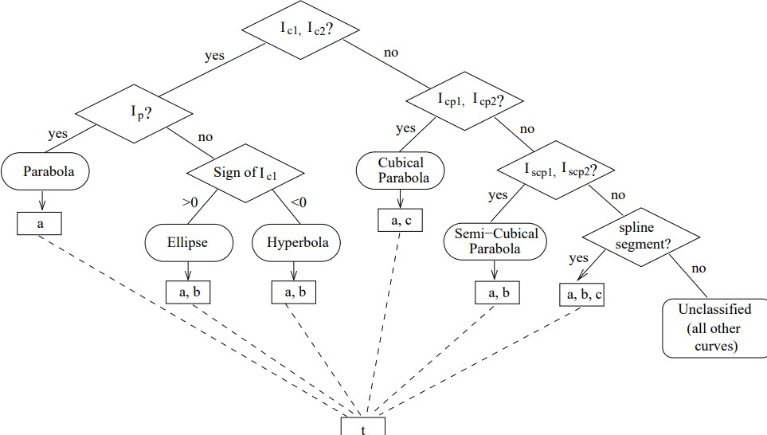
Shape Recognition Tree
A robotic hand can recognize curved shapes
from differential invariants (expressions of curvature, torsion, etc.) constructed over tactile data.
// Do values of 𝐼_{𝑐1} and 𝐼_{𝑐2} vary at
// different contour points (i.e., are they
// invariants on the shape)?
https://faculty.sites.iastate.edu/jia/files/inline-files/IJRR05.pdf

Slide 14
Why Decision Trees?
They yield nice, concise, and understandable results.
They represent simple rules for classifying instances that are described by discrete attribute values.
Decision tree learning algorithms are relatively efficient – linear in the size of the decision tree and the size of the data set.
Decision trees are often among the first to be tried on a new
data set.
♠ They are not good with real-valued attributes.

Slide 15

Expressiveness of a Decision Tree
Equivalent logical statement of a decision tree:
Output ⇔ Path₁ ∨ Path₂ ∨ ⋯
(one statement for Output = Yes
and another for Output = No)
where
Path_{𝑖} = (𝐴_{𝑖1} = 𝑣_{𝑖1} ∧ 𝐴_{𝑖2} = 𝑣_{𝑖2} ∧ ⋯ )
Path₁
Path_{𝑛}
⋯
yes
yes
yes

Slide 16
Expressiveness of a Decision Tree
Equivalent logical statement of a decision tree:
Output ⇔ Path₁ ∨ Path₂ ∨ ⋯
(one statement for Output = Yes
and another for Output = No)
where
Path_{𝑖} = (𝐴_{𝑖1} = 𝑣_{𝑖1} ∧ 𝐴_{𝑖2} = 𝑣_{𝑖2} ∧ ⋯ )
Path₁
Path_{𝑛}
⋯
attribute value
yes
yes
yes

Slide 17
Expressiveness of a Decision Tree
Equivalent logical statement of a decision tree:
Output ⇔ Path₁ ∨ Path₂ ∨ ⋯
(one statement for Output = Yes
and another for Output = No)
Disjunctive normal form (DNF)
where
Path_{𝑖} = (𝐴_{𝑖1} = 𝑣_{𝑖1} ∧ 𝐴_{𝑖2} = 𝑣_{𝑖2} ∧ ⋯ )
Path₁
Path_{𝑛}
⋯
attribute value
yes
yes
yes

Slide 18
Expressiveness of a Decision Tree
Equivalent logical statement of a decision tree:
Output ⇔ Path₁ ∨ Path₂ ∨ ⋯
(one statement for Output = Yes
and another for Output = No)
Disjunctive normal form (DNF)
where
Path_{𝑖} = (𝐴_{𝑖1} = 𝑣_{𝑖1} ∧ 𝐴_{𝑖2} = 𝑣_{𝑖2} ∧ ⋯ )
Path₁
Path_{𝑛}
⋯
attribute value
yes
yes
yes
Any sentence in propositional logic can be converted into a DNF.

Slide 19
Expressiveness of a Decision Tree
Equivalent logical statement of a decision tree:
Output ⇔ Path₁ ∨ Path₂ ∨ ⋯
(one statement for Output = Yes
and another for Output = No)
Disjunctive normal form (DNF)
where
Path_{𝑖} = (𝐴_{𝑖1} = 𝑣_{𝑖1} ∧ 𝐴_{𝑖2} = 𝑣_{𝑖2} ∧ ⋯ )
Path₁
Path_{𝑛}
⋯
attribute value
yes
yes
yes
Any sentence in propositional logic can be converted into a DNF.
Any sentence in propositional logic can expressed as a decision tree.

Slide 20
II. Learning DTs from Examples
Problem Find a tree that is
consistent with the training examples and
as small as possible.

Slide 21
II. Learning DTs from Examples
Problem Find a tree that is
consistent with the training examples and
as small as possible.

Slide 22
II. Learning DTs from Examples
Problem Find a tree that is
consistent with the training examples and
as small as possible.
Generally, it’s intractable to find a smallest consistent tree.

Slide 23
II. Learning DTs from Examples
Problem Find a tree that is
consistent with the training examples and
as small as possible.
Generally, it’s intractable to find a smallest consistent tree.
A suboptimal tree can be constructed with some simple heuristics.

Slide 24
II. Learning DTs from Examples
Problem Find a tree that is
consistent with the training examples and
as small as possible.
Generally, it’s intractable to find a smallest consistent tree.
A suboptimal tree can be constructed with some simple heuristics.
Greedy divide-and-conquer strategy:
  Test the most important attribute first.

Slide 25
II. Learning DTs from Examples
Problem Find a tree that is
consistent with the training examples and
as small as possible.
Generally, it’s intractable to find a smallest consistent tree.
A suboptimal tree can be constructed with some simple heuristics.
Greedy divide-and-conquer strategy:
  Test the most important attribute first.
make the most difference to the classification

Slide 26
II. Learning DTs from Examples
Problem Find a tree that is
consistent with the training examples and
as small as possible.
Generally, it’s intractable to find a smallest consistent tree.
A suboptimal tree can be constructed with some simple heuristics.
Greedy divide-and-conquer strategy:
  Test the most important attribute first.
make the most difference to the classification
  Recursively solve the smaller subproblems.

Slide 27
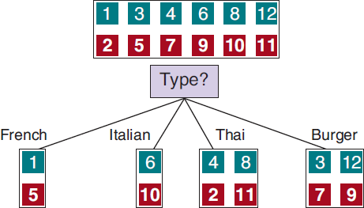
Poor and Good Attributes
Poor attribute Type:

Slide 28
Poor and Good Attributes
Poor attribute Type:
♠ four outcomes

Slide 29
Poor and Good Attributes
Poor attribute Type:
♠ four outcomes
♠ each with the same number
of positive as negative examples

Slide 30
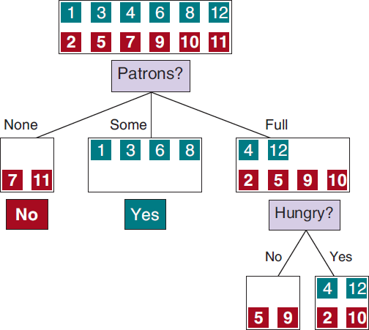
Poor and Good Attributes
Poor attribute Type:
♠ four outcomes
♠ each with the same number
of positive as negative examples
Good attributes Patrons and Hungry:

Slide 31
Poor and Good Attributes
Poor attribute Type:
♠ four outcomes
♠ each with the same number
of positive as negative examples
Good attributes Patrons and Hungry:
effective separations of positive and negative examples

Slide 32
Four Cases
1. All positive (or all negative) remaining examples.
Done.

Slide 33
Four Cases
All positive (or all negative) remaining examples.
Done.
Mixed positive and negative remaining examples.
Choose the best attribute to split them.

Slide 34
Four Cases
All positive (or all negative) remaining examples.
Done.
Mixed positive and negative remaining examples.
Choose the best attribute to split them.
No examples left.
𝐴_{𝑖}?
𝑣₁
𝑣₂ 𝑣₃

Slide 35
Four Cases
All positive (or all negative) remaining examples.
Done.
Mixed positive and negative remaining examples.
Choose the best attribute to split them.
No examples left.
Return the most common output value (e.g., •) for the example set used in
constructing the parent (𝐴_{𝑖}?)
𝐴_{𝑖}?
𝑣₁
𝑣₂ 𝑣₃

Slide 36
Four Cases
All positive (or all negative) remaining examples.
Done.
Mixed positive and negative remaining examples.
Choose the best attribute to split them.
No examples left.
Return the most common output value (e.g., •) for the example set used in
constructing the parent (𝐴_{𝑖}?)
𝐴_{𝑖}?
𝑣₁
𝑣₂ 𝑣₃
Yes
(6 • vs 4 • in the set queried with 𝐴_{𝑖}?)

Slide 37

Four Cases
All positive (or all negative) remaining examples.
Done.
Mixed positive and negative remaining examples.
Choose the best attribute to split them.
No examples left.
Return the most common output value (e.g., •) for the example set used in
constructing the parent (𝐴_{𝑖}?)
𝐴_{𝑖}?
𝑣₁
𝑣₂ 𝑣₃
Yes
(6 • vs 4 • in the set queried with 𝐴_{𝑖}?)
4. No attributes left but both positive and negative
examples.

Slide 38
Four Cases
All positive (or all negative) remaining examples.
Done.
Mixed positive and negative remaining examples.
Choose the best attribute to split them.
No examples left.
Return the most common output value (e.g., •) for the example set used in
constructing the parent (𝐴_{𝑖}?)
𝐴_{𝑖}?
𝑣₁
𝑣₂ 𝑣₃
Yes
(6 • vs 4 • in the set queried with 𝐴_{𝑖}?)
4. No attributes left but both positive and negative
examples.
Return the most common output value of these examples (by a majority vote)

Slide 39
Four Cases
All positive (or all negative) remaining examples.
Done.
Mixed positive and negative remaining examples.
Choose the best attribute to split them.
No examples left.
Return the most common output value (e.g., •) for the example set used in
constructing the parent (𝐴_{𝑖}?)
𝐴_{𝑖}?
𝑣₁
𝑣₂ 𝑣₃
Yes
(6 • vs 4 • in the set queried with 𝐴_{𝑖}?)
4. No attributes left but both positive and negative
examples.
Return the most common output value of these examples (by a majority vote)
No

Slide 40
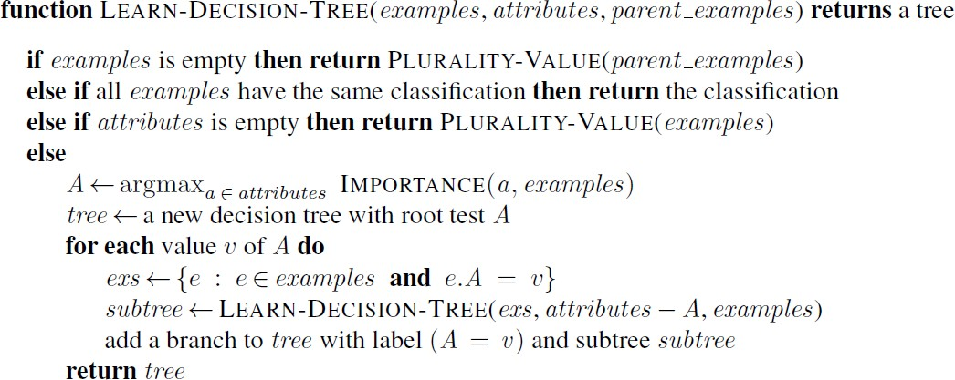
Algorithm for Learning DTs
// case 3
// case 1
// case 4
// case 2

Slide 41
Algorithm for Learning DTs
// case 3
// case 1
// case 4
// case 2

Slide 42
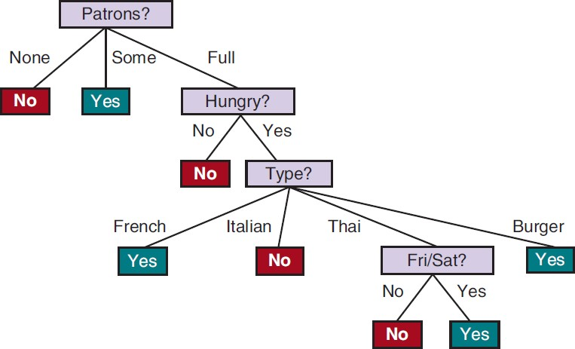
Output Decision Tree
𝑇₂

Slide 43

Output Decision Tree
𝑇₂
Original decision tree 𝑇₁

Slide 44
Output Decision Tree
𝑇₂
Considerably simpler!
Original decision tree 𝑇₁

Slide 45
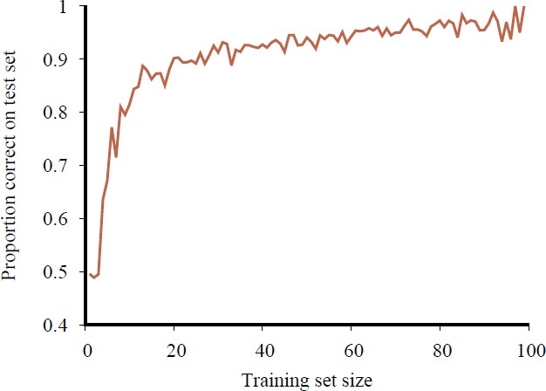
Learning Curve
“happy graph”
100 randomly generated examples in the restaurant domain.
Split them randomly into a training set and a test set.
  Split 20 times for each size (1 – 99) of the training set.
  Average the results of the 20 trials.

Slide 46
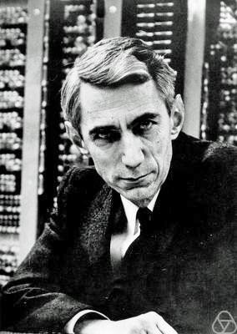
III. Entropy and Attribute Choice
Importance of an attribute is measured using the notion of information gain defined in terms of (Shannon) entropy.
measure of the uncertainty of a random variable:
the more information, the less entropy.
Claude Shannon (MIT)
“Father of information theory” National Medal of Science (1966)

Slide 47
III. Entropy and Attribute Choice
Importance of an attribute is measured using the notion of information gain defined in terms of (Shannon) entropy.
measure of the uncertainty of a random variable:
the more information, the less entropy.
A fair coin has 1 bit of entropy as it is equally likely to come up heads and tails when flipped.
Claude Shannon (MIT)
“Father of information theory” National Medal of Science (1966)

Slide 48
III. Entropy and Attribute Choice
Importance of an attribute is measured using the notion of information gain defined in terms of (Shannon) entropy.
measure of the uncertainty of a random variable:
the more information, the less entropy.
A fair coin has 1 bit of entropy as it is equally likely to come up heads and tails when flipped.
Claude Shannon (MIT)
“Father of information theory”
A four-sided die has 2 bits of entropy since there are 2² equally likely choices.
National Medal of Science (1966)

Slide 49
III. Entropy and Attribute Choice
Importance of an attribute is measured using the notion of information gain defined in terms of (Shannon) entropy.
measure of the uncertainty of a random variable:
the more information, the less entropy.
A fair coin has 1 bit of entropy as it is equally likely to come up heads and tails when flipped.
Claude Shannon (MIT)
“Father of information theory”
A four-sided die has 2 bits of entropy since there are 2² equally likely choices.
National Medal of Science (1966)
An unfair coin that comes up heads 99% of the time would have an entropy measure that is close to zero.

Slide 50
Entropy
Random variable 𝑉 with values 𝑣_{𝑘} having probability 𝑃 𝑣_{𝑘} .
Entropy of 𝑉:
1
𝐻 𝑉
= ෍ 𝑃(𝑣 ) log
𝑘
2
𝑃(𝑣 )
𝑘
𝑘
= − ෍ 𝑃(𝑣_{𝑘}) log₂ 𝑃(𝑣_{𝑘})
𝑘

Slide 51
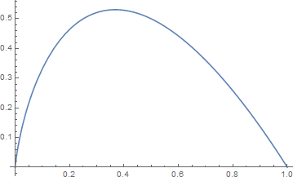
Entropy
Random variable 𝑉 with values 𝑣_{𝑘} having probability 𝑃 𝑣_{𝑘} .
Entropy of 𝑉:
1
−𝑥 log₂ 𝑥
𝐻 𝑉
= ෍ 𝑃(𝑣 ) log
𝑘
2
𝑃(𝑣 )
𝑘
𝑘
= − ෍ 𝑃(𝑣_{𝑘}) log₂ 𝑃(𝑣_{𝑘})
𝑘

Slide 52
Entropy
Random variable 𝑉 with values 𝑣_{𝑘} having probability 𝑃 𝑣_{𝑘} .
Entropy of 𝑉:
1
−𝑥 log₂ 𝑥
𝐻 𝑉
= ෍ 𝑃(𝑣 ) log
𝑘
2
𝑃(𝑣 )
𝑘
𝑘
= − ෍ 𝑃(𝑣_{𝑘}) log₂ 𝑃(𝑣_{𝑘})
𝑘
Entropy measures the expected amount of information conveyed by identifying the outcome of a random trial.

Slide 53
Entropy Examples
A fair coin
𝐻 Fair = − 0.5 log₂ 0.5 + 0.5 log₂ 0.5 = 1 (bit)
There is maximum surprise in this case.

Slide 54
Entropy Examples
A fair coin
𝐻 Fair = − 0.5 log₂ 0.5 + 0.5 log₂ 0.5 = 1 (bit)
There is maximum surprise in this case.
A coin with known outcome (e.g., head)
𝐻 Head = −1 ∙ log₂ 1 = 0 (bit)
There is no uncertainty at all – no information.

Slide 55
Entropy Examples
A fair coin
𝐻 Fair = − 0.5 log₂ 0.5 + 0.5 log₂ 0.5
There is maximum surprise in this case.
= 1 (bit)
A coin with known outcome (e.g., head)
𝐻 Head = −1 ∙ log₂ 1 = 0 (bit)
There is no uncertainty at all – no information.
A loaded coin with 99% heads
𝐻 Loaded = − 0.99 log₂ 0.99 + 0.01 log₂ 0.01 ≈ 0.08 (bits)

Slide 56
Entropy Examples
A fair coin
𝐻 Fair = − 0.5 log₂ 0.5 + 0.5 log₂ 0.5
There is maximum surprise in this case.
= 1 (bit)
A coin with known outcome (e.g., head)
𝐻 Head = −1 ∙ log₂ 1 = 0 (bit)
There is no uncertainty at all – no information.
A loaded coin with 99% heads
𝐻 Loaded = − 0.99 log₂ 0.99 + 0.01 log₂ 0.01 ≈ 0.08 (bits)
A four-sided die
𝐻 Die4
= − 4 ∙ 0.25 log₂ 0.25 = 2 (bits)

Slide 57
Entropy of a Boolean Variable
A Boolean random variable that is true with probability 𝑞.
𝐵 𝑞 = −(𝑞 log₂ 𝑞 + (1 − 𝑞) log₂(1 − 𝑞))

Slide 58
Entropy of a Boolean Variable
A Boolean random variable that is true with probability 𝑞.
𝐵 𝑞 = −(𝑞 log₂ 𝑞 + (1 − 𝑞) log₂(1 − 𝑞))
𝐵 𝑞
= 𝐵(1 − 𝑞)

Slide 59
Entropy of a Boolean Variable
A Boolean random variable that is true with probability 𝑞.
𝐵 𝑞 = −(𝑞 log₂ 𝑞 + (1 − 𝑞) log₂(1 − 𝑞))
𝐵 𝑞
= 𝐵(1 − 𝑞)
𝐻 Loaded = 𝐵(0.99) ≈ 0.08

Slide 60
Entropy of a Boolean Variable
A Boolean random variable that is true with probability 𝑞.
𝐵 𝑞 = −(𝑞 log₂ 𝑞 + (1 − 𝑞) log₂(1 − 𝑞))
𝐵 𝑞
= 𝐵(1 − 𝑞)
𝐻 Loaded = 𝐵(0.99) ≈ 0.08
A training set contains 𝑝 positive examples and 𝑛 negative examples.

Slide 61
Entropy of a Boolean Variable
A Boolean random variable that is true with probability 𝑞.
𝐵 𝑞 = −(𝑞 log₂ 𝑞 + (1 − 𝑞) log₂(1 − 𝑞))
𝐵 𝑞
= 𝐵(1 − 𝑞)
𝐻 Loaded = 𝐵(0.99) ≈ 0.08
A training set contains 𝑝 positive examples and 𝑛 negative examples.
𝑝
𝐻 Output = 𝐵
𝑝 + 𝑛

Slide 62
Entropy of a Boolean Variable
A Boolean random variable that is true with probability 𝑞.
𝐵 𝑞 = −(𝑞 log₂ 𝑞 + (1 − 𝑞) log₂(1 − 𝑞))
𝐵 𝑞
= 𝐵(1 − 𝑞)
𝐻 Loaded = 𝐵(0.99) ≈ 0.08
A training set contains 𝑝 positive examples and 𝑛 negative examples.
𝑝
𝐻 Output = 𝐵
𝑝 + 𝑛

Slide 63
Entropy of a Boolean Variable
A Boolean random variable that is true with probability 𝑞.
𝐵 𝑞 = −(𝑞 log₂ 𝑞 + (1 − 𝑞) log₂(1 − 𝑞))
𝐵 𝑞
= 𝐵(1 − 𝑞)
𝐻 Loaded = 𝐵(0.99) ≈ 0.08
A training set contains 𝑝 positive examples and 𝑛 negative examples.
𝑝
𝐻 Output = 𝐵
𝑝 + 𝑛
𝑝 = 𝑛 = 6

Slide 64
Entropy of a Boolean Variable
A Boolean random variable that is true with probability 𝑞.
𝐵 𝑞 = −(𝑞 log₂ 𝑞 + (1 − 𝑞) log₂(1 − 𝑞))
𝐵 𝑞
= 𝐵(1 − 𝑞)
𝐻 Loaded = 𝐵(0.99) ≈ 0.08
A training set contains 𝑝 positive examples and 𝑛 negative examples.
𝑝
𝐻 Output = 𝐵
𝑝 + 𝑛
𝑝 = 𝑛 = 6
𝐵 0.5 = 1

Slide 65
Choice of an Attribute
An attribute 𝐴 has 𝑑 distinct values.

Slide 66
Choice of an Attribute
An attribute 𝐴 has 𝑑 distinct values.
𝐴 divides the training set 𝐸 into subsets 𝐸₁, … , 𝐸_{𝑑}.

Slide 67
Choice of an Attribute
An attribute 𝐴 has 𝑑 distinct values.
𝐴 divides the training set 𝐸 into subsets 𝐸₁, … , 𝐸_{𝑑}.
  Each subset 𝐸_{𝑘} has 𝑝_{𝑘} positive examples and 𝑛_{𝑘} negative examples.
𝑑
𝑝 = ෍ 𝑝_{𝑘}
𝑘=1
𝑑
𝑛 = ෍ 𝑛_{𝑘}
𝑘=1
and

Slide 68
Choice of an Attribute
An attribute 𝐴 has 𝑑 distinct values.
𝐴 divides the training set 𝐸 into subsets 𝐸₁, … , 𝐸_{𝑑}.
  Each subset 𝐸_{𝑘} has 𝑝_{𝑘} positive examples and 𝑛_{𝑘} negative examples.
𝑑
𝑝 = ෍ 𝑝_{𝑘}
𝑘=1
𝑑
𝑛 = ෍ 𝑛_{𝑘}
𝑘=1
and
This implies an additional 𝐵
𝑝_{𝑘}
bits of information.
𝑝_{𝑘}+𝑛_{𝑘}

Slide 69
Choice of an Attribute
An attribute 𝐴 has 𝑑 distinct values.
𝐴 divides the training set 𝐸 into subsets 𝐸₁, … , 𝐸_{𝑑}.
  Each subset 𝐸_{𝑘} has 𝑝_{𝑘} positive examples and 𝑛_{𝑘} negative examples.
𝑑
𝑝 = ෍ 𝑝_{𝑘}
𝑘=1
𝑑
𝑛 = ෍ 𝑛_{𝑘}
𝑘=1
and
This implies an additional 𝐵
𝑝_{𝑘}
bits of information.
𝑝_{𝑘}+𝑛_{𝑘}
Consider a randomly chosen example from the training set.
  Its attribute 𝐴 value is in 𝐸_{𝑘} with probability 𝑝_{𝑘} + 𝑛_{𝑘} / 𝑝 + 𝑛 .

Slide 70
Choice of an Attribute
An attribute 𝐴 has 𝑑 distinct values.
𝐴 divides the training set 𝐸 into subsets 𝐸₁, … , 𝐸_{𝑑}.
  Each subset 𝐸_{𝑘} has 𝑝_{𝑘} positive examples and 𝑛_{𝑘} negative examples.
𝑑
𝑝 = ෍ 𝑝_{𝑘}
𝑘=1
𝑑
𝑛 = ෍ 𝑛_{𝑘}
𝑘=1
and
This implies an additional 𝐵
𝑝_{𝑘}
bits of information.
𝑝_{𝑘}+𝑛_{𝑘}
Consider a randomly chosen example from the training set.
  Its attribute 𝐴 value is in 𝐸_{𝑘} with probability 𝑝_{𝑘} + 𝑛_{𝑘} / 𝑝 + 𝑛 .
Expected entropy remaining after testing attribute 𝐴 is
𝑝_{𝑘}+𝑛_{𝑘 𝐵}
𝑝_{𝑘}
𝑝_{𝑘}+𝑛_{𝑘}
Remainder 𝐴 = σ^{𝑑}
𝑘=1
𝑝+𝑛

Slide 71
Information Gain
Expected reduction in entropy from the attribute test on 𝐴:
𝑝
𝑝 + 𝑛
Gain 𝐴 = 𝐵
− Remainder 𝐴
𝑝
𝑑
𝑝_{𝑘} + 𝑛_{𝑘}
− ෍ 𝐵
𝑝_{𝑘}
= 𝐵
𝑝 + 𝑛
𝑝 + 𝑛
𝑝_{𝑘} + 𝑛_{𝑘}
𝑘=1
Choose the attribute 𝐴 among the remaining attributes to maximize
Gain 𝐴 .

Slide 72
Information Gain
𝑑
− ෍
𝑘=1
𝑝_{𝑘} + 𝑛_{𝑘 𝐵} 𝑝_{𝑘}
𝑝 + 𝑛 𝑝_{𝑘} + 𝑛_{𝑘}
𝑝
Gain 𝐴 = 𝐵
𝑝 + 𝑛

Slide 73
Information Gain
𝑑
− ෍
𝑘=1
𝑝_{𝑘} + 𝑛_{𝑘 𝐵} 𝑝_{𝑘}
𝑝 + 𝑛 𝑝_{𝑘} + 𝑛_{𝑘}
𝑝
Gain 𝐴 = 𝐵
𝑝 + 𝑛
1
2
2 _{𝐵} 1
2
2 _{𝐵} 1
2
4 _{𝐵} 2
4
4 _{𝐵} 2
4
Gain Type = 𝐵
−
+
+
+
= 0 bits
12
12
12
12

Slide 74
Information Gain
𝑑
− ෍
𝑘=1
𝑝_{𝑘} + 𝑛_{𝑘 𝐵} 𝑝_{𝑘}
𝑝 + 𝑛 𝑝_{𝑘} + 𝑛_{𝑘}
𝑝
Gain 𝐴 = 𝐵
𝑝 + 𝑛
1
2
2 _{𝐵} 1
2
2 _{𝐵} 1
2
4 _{𝐵} 2
4
4 _{𝐵} 2
4
Gain Type = 𝐵
−
+
+
+
= 0 bits
12
12
12
12

Slide 75
Information Gain
𝑑
− ෍
𝑘=1
𝑝_{𝑘} + 𝑛_{𝑘 𝐵} 𝑝_{𝑘}
𝑝 + 𝑛 𝑝_{𝑘} + 𝑛_{𝑘}
𝑝
Gain 𝐴 = 𝐵
𝑝 + 𝑛
1
2
2 _{𝐵} 1
2
2 _{𝐵} 1
2
4 _{𝐵} 2
4
4 _{𝐵} 2
4
Gain Type = 𝐵
−
1
2
+
2 _{𝐵} 0
2
+
4 _{𝐵} 4
4
+
6 _{𝐵} 2
6
= 0 bits
12
12
12
12
Gain Patrons = 𝐵
−
+
+
≈ 0.541 bits
12
12
12

Slide 76

Information Gain
𝑑
− ෍
𝑘=1
𝑝_{𝑘} + 𝑛_{𝑘 𝐵} 𝑝_{𝑘}
𝑝 + 𝑛 𝑝_{𝑘} + 𝑛_{𝑘}
𝑝
Gain 𝐴 = 𝐵
𝑝 + 𝑛
1
2
2 _{𝐵} 1
2
2 _{𝐵} 1
2
4 _{𝐵} 2
4
4 _{𝐵} 2
4
Gain Type = 𝐵
−
1
2
+
2 _{𝐵} 0
2
+
4 _{𝐵} 4
4
+
6 _{𝐵} 2
6
= 0 bits
12
12
12
12
Gain Patrons = 𝐵
−
+
+
≈ 0.541 bits
12
12
12

